Slide 1

Subject Code: SCS1301 Subject Name: Operating System Faculty Name: Dr. A. Jesudoss

Slide 2
Roadmap to UNIT I
Introduction
Operating system structures
System Components
OS Services
System Calls
System Structure
Resources
Processes
Threads
Objects
Device Management
Different approaches
Buffering device drivers.

Slide 3
RESOURCES
• The OS treats an entity as a resource if it satisfies the below characteristics:
o A process must request it from the OS.
o A process must suspend its operation until the entity is allocated to it.
• The most common source is a file. A process must request a file before it can read it or write it.
Further, if the file is unavailable,the process must wait until it becomes available.
This abstract description of a resource is crucial to the way various entities(such as files,memory and devices) are managed.
Files
• A sequential file is a named linear stream bytes of memory.
• You can store information by opeening a file

Slide 4
PROCESS
An operating system executes a variety of programs:
o Batch system – jobs
o Time-shared systems – user programs or tasks
Process – a program in execution; process execution must progress in sequential fashion.
A process is more than the program code, which is sometimes known as the text section. A process includes:
1. Program counter
2. Stack
3. Data section
The current activity, as represented by the value of the Program counter and the contents of the processor's registers.

Slide 5
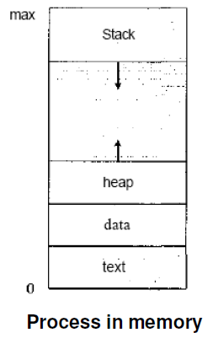
The process Stack contains temporary data (such as function parameters, return addresses, and local variables), Data section, which contains global variables.
• A process may also include a heap, which is memory that is dynamically allocated during process run time.

Slide 6
• A program by itself is not a process; a program is a passive entity, such as a file containing a list of instructions stored on disk (often called an executable file).
Whereas a process is an active entity, with a program counter specifying the next instruction to execute and a set of associated resources.
A program becomes a process when an executable file is loaded into memory.
• Two common techniques for loading executable files are double-clicking an icon representing the executable file and entering the name of the executable file on the command line (as in
prog. exe or a. out.)

Slide 7
Although two processes may be associated with the same program, they are nevertheless considered two separate execution sequences.
Several users may be running different copies of the mail program, or the same user may invoke many copies of the web browser program.
• Each of these is a separate process; and although the text sections are equivalent, the data, heap, and stack sections vary.
It is also common to have a process that spawns many processes as it runs.

Slide 8
THREADS
A thread is a basic unit of CPU utilization. A thread,sometimes called as light weight process whereas a process is a heavyweight process.
• Thread comprises:
o A thread ID
o A program counter
o A register set
o A stack.
• A process is a program that performs a single thread of execution i.e., a process is a executing program with a single thread of control.
For example, when a process is running a wordprocessor
program, a single thread of instructions is being executed.

Slide 9
• This single thread of control allows the process to perform only one task at one time. For example, the user cannot simultaneously type in characters and run the spell checker within the same process.
• Traditionally a process contained only a single thread of control as it ran, many modern operating systems have extended the process concept to allow a process to have multiple threads of execution and thus to perform more than one task at a time.

Slide 10
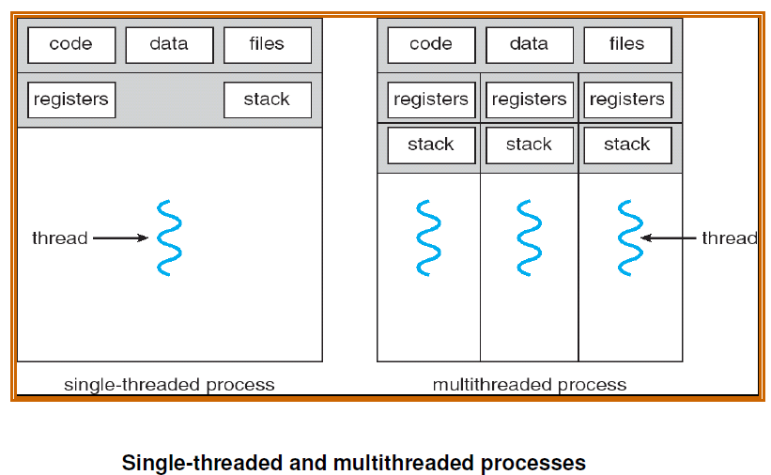

Slide 11
• The operating system is responsible for the following activities in connection with process and thread management:
o The creation and deletion of both user and system processes;
o The scheduling of processes;
o The provision of mechanisms for synchronization,
o Communication,
o Deadlock handling for processes.
Benefits
The benefits of multi threaded programming can be broken down into four major categories:
Responsiveness
Resource sharing
Economy
Utilization of multiprocessor architectures

Slide 12
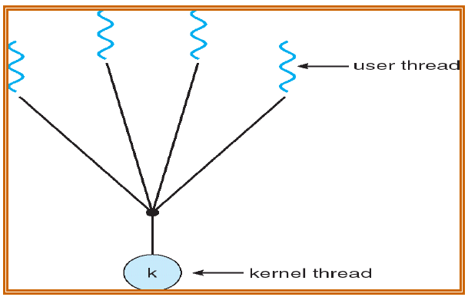
Multithreading Models
Many systems provide support for both user and kernel threads, resulting in different multi threading models. Three common ways of establishing this relationship are:
Many-to-One Model

Slide 13
The many-to-one model maps many user-level threads to one kernel thread.
Thread management is done by the thread library in user space, so it is efficient; but the entire process will block if a thread makes a blocking system call.
• Also, because only one thread can access the kernel at a time, multiple threads are unable to run in parallel on multiprocessors. Green threads—a thread library available for Solaris 2—uses this model.
• In addition, user level thread libraries implemented on Operating systems that do not support kernel threads use the many-to-one model.

Slide 14
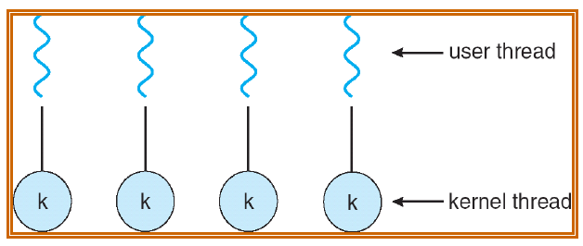
One-to-One Model
The one-to-one model maps each user thread to a kernel thread.
It provides more concurrency than the many-to-one model by allowing another thread to run when a thread makes a blocking system call; it also allows multiple threads to run in parallel on multiprocessors.
• The only drawback to this model is that creating a user thread requires creating the corresponding kernel thread.

Slide 15
• Because the overhead of creating kernel threads can burden the performance of an application, most implementations of this model restrict the number of threads supported by the system.
• Linux, along with the family of Windows operating systems—including Windows 95, 98, NT, 2000, and OS/2— implement the one-to-one model.
Many-to-Many Model
• The many-to-many model multiplexes many user-level threads to a smaller or equal number of kernel threads.

Slide 16
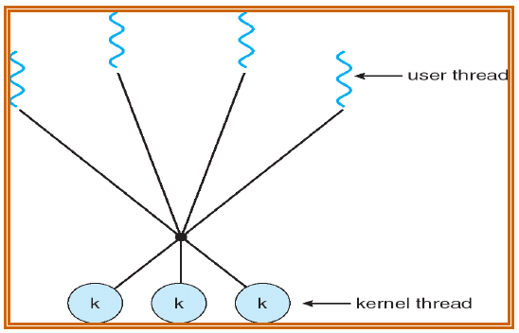
The number of kernel threads may be specific to either a particular application or a particular machine (an application may be allocated more kernel threads on a multiprocessor than on a uniprocessor).
Whereas the many-to-one model allows the developer to create as many user threads as she wishes, true concurrency is not gained because the kernel can schedule only one thread at a time.

Slide 17
• The one-to-one model allows for greater concurrency, but the developer has to be careful not to create too many threads within an application (and in some instances may be limited in the number of threads she can create).
• The many-to-many model suffers from neither of these shortcomings:
Developers can create as many user threads as necessary, and the corresponding kernel threads can run in parallel on a multiprocessor.
Also, when a thread performs a blocking system call, the kernel can schedule another thread for execution.
Solaris 2, IRIX, HP-UX and Tru64 UNIX support this model.

Slide 18
PROCESSES Vs. THREADS
How threads differ from processes
• Threads differ from traditional multitasking operating system processes:
o processes are typically independent, while threads exist as subsets of a process.
processes carry considerably more state information than threads, whereas multiple threads within a process share process state as well as memory and other resources
o processes have separate address spaces, whereas threads share their address space. Processes interact only through system-provided inter-process communication mechanisms

Slide 19
o Context switching between threads in the same process is typically faster than context switching between processes.
As we mentioned earlier that in many respect threads operate in the same way as that of processes. Some of the similarities and
differences are:
Similarities
• Like processes threads share CPU and only one thread active (running) at a time.
• Like processes, threads within a processes, threads within a processes execute sequentially.
• Like processes, thread can create children.
• And like process, if one thread is blocked, another thread can run.

Slide 20
Differences
• Unlike processes, threads are not independent of one another.
• Unlike processes, all threads can access every address in the task .
• Unlike processes, thread are design to assist one other. Note that processes might or might not assist one another because processes may originate from different users.

Slide 21
OBJECTS
Objects are the basic run time entities in an object-oriented system.
They may represent a person, a place, a bank account,a table of data or any item that the program has to handle.
Programming problem is analysed in terms of objects and the nature of communication between them.
When a program is executed,the objects interact by sending messages to one another.
For example, if ‘customer’ and ‘account’ are the two objects in a program, then the customer object may send a message to the account object.
Each object contains data and code to manipulate the data.

Slide 22
Objects can interact without having to know details of each others
data or code.
It is sufficient to know the type of message accepted,and the type of response returned by the objects.

Slide 23
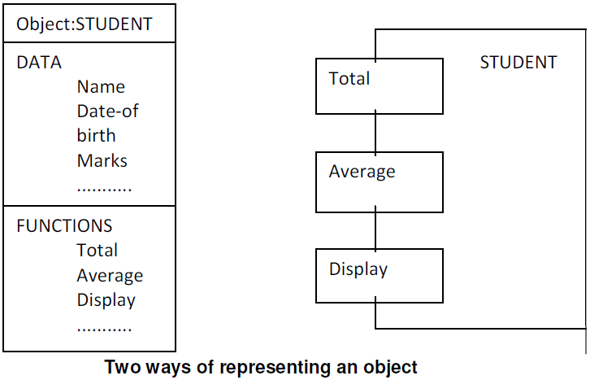

Slide 24
• Real-world objects share two characteristics: They all have state and behavior.
• Desktop lamp may have only two possible states (on and off) and two possible behaviors (turn on, turn off), but your desktop radio might have additional states (on, off, current volume, current station) and behavior (turn on, turn off, increase volume, decrease volume, seek, scan, and tune).
• You may also notice that some objects, in turn, will also contain other objects.
• These real-world observations all translate into the world of object-oriented programming.

